Slide 1

01
Introduction to NN, CNN and GNN (24AIM113) & Analog System Design (24AIM114)
SMART POSTURE CORRECTION SYSTEM
CB.AI.U4AIM24007- ARNITA N CB.AI.U4AIM24021- THANMAI SAI K CB.AI.U4AIM24035- SAI PRANAVI R CB.AI.U4AIM24040- SHREENIDHI G
TEAM MEMBERS :
FACULTY :
Dr. SnigdhaTanu Acharya
Dr. Amrutha V

Slide 2
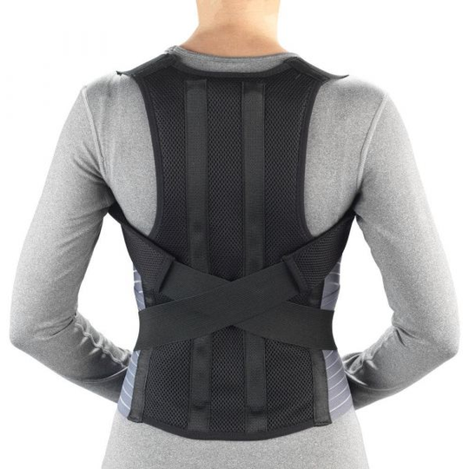
02
STRAIGHT UP:
This is designed to monitor and classify back posture using an MPU6050 IMU sensor and an ESP32 microcontroller.
Components used:
1. ESP-32 microcontroller
2.MPU 6050
3.Vibration motor
4.Belt

Slide 3
03
PROBLEMS FACED:
SI.NO. | Challenges Encountered | Solution
1. | We faced a problem in finding the suitable board for ESP32 in the Arduino IDE. | We are able to figure it out from Github links, Sent by lab assistant.
2. | We faced a problem in selecting suitable IMU sensor whether it is MPU6050 OR MPU9050. | The MPU9050 includes a magnetometer in addition to the 6-axis accelerometer and gyroscope, which is not required for our project. Therefore, we chose the MPU6050.
3 | We were unable to connect the ESP32 to the Arduino IDE via Bluetooth. | For now we are using USB cable in place of bluetooth connection.

Slide 4
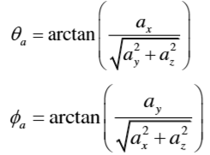
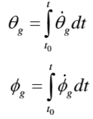
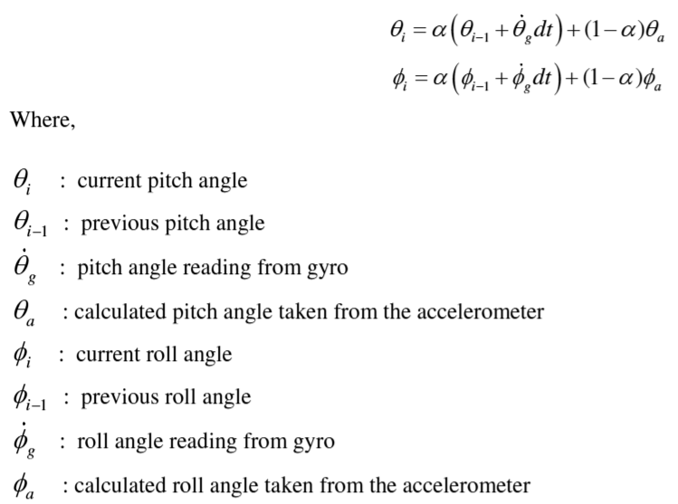
04
ANGLES:
STEP 2: HOW TO CALCULATE ANGLES
STEP 1: RANGE OF VALUES FOR CATEGORY
Gyroscope data- for inclination angles:
Sensor Position | Angle | Good Posture Range | Bad Posture Range
Upper Thoracic | Pitch | -5° to +5° | > +15° (Forward Slouch)
Upper Thoracic | Roll | -3° to +3° | > ±10° (Lateral Lean)
Right Shoulder | Roll | -3° to +3° | > +8° (Shoulder Hike)
For forward /backward leaning:
Pitch=
For side-to-side leaning:
Roll=
Low-pass filter: Reduces accelerometer jitter.
High-pass filter: Minimizes gyro drift.
Fusion: Combines both for realistic output.
The complimentary filters iteratively update the Euler angles by the following formulas:
Complementary Filter:
Source: Malik, Nayyer Nayab, M. Javed Hyder, and Ajmal Shah. "EXPERIMENTAL INVESTIGATION ON TECHNIQUES TO IMPROVE THE ACCURACY OF MPU 6050 FOR TILT MEASUREMENT." JOURNAL OF HARBIN INSTITUTE OF TECHNOLOGY 54.9: 2022.

Slide 5
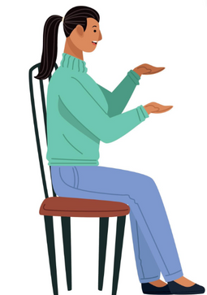

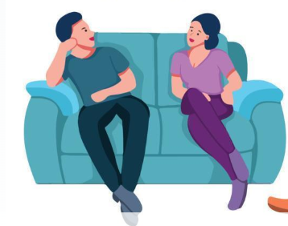

05
POSTURES:
GOOD
BAD
Forward Slouch: Pitch angle greater than +15°.
Backward Slouch: Pitch angle less than -15°.
Pitch angle between -5° and +5°
Roll angle between -3° and +3°
Side-to-Side Slouch: Roll angle greater than ±10°.
Feature | Acc1_X | Acc1_Y | Acc1_Z | Gyr1_X | Gyr1_Y | Gyr1_Z | Acc2_X | Acc2_Y | Acc2_Z | Gyr2_X | Gyr2_Y | Gyr2_Z | Pitch | Roll | Posture Type
1 | 9.07 | -1.06 | 4.32 | -0.08 | -0.03 | 0.02 | -3.54 | -2.77 | 7.41 | -0.07 | 0.02 | -0.01 | 2.50 | -1.20 | Good
2 | 6.94 | 3.21 | 6.34 | -0.03 | -0.01 | -0.01 | -7.23 | 3.36 | 4.25 | -0.05 | 0.03 | -0.01 | 18.00 | 12.00 | Bad

Slide 6
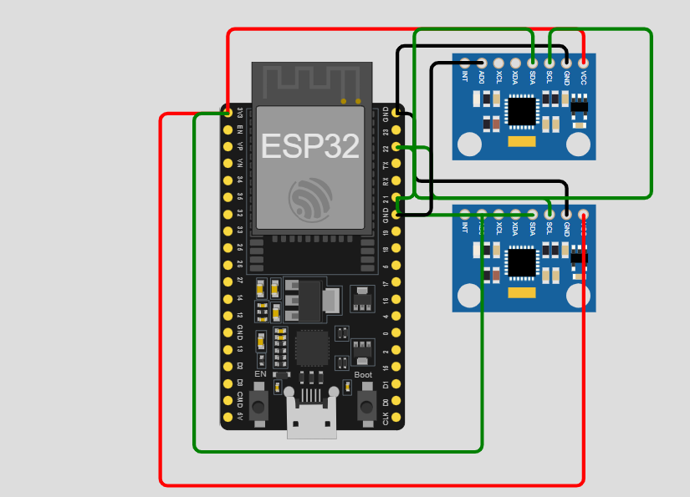
CIRCUIT DIAGRAM
06
https://wokwi.com/projects/422158056135560193

Slide 7
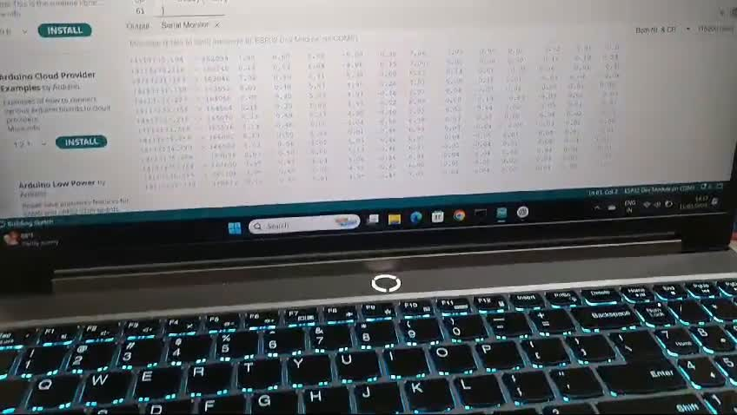
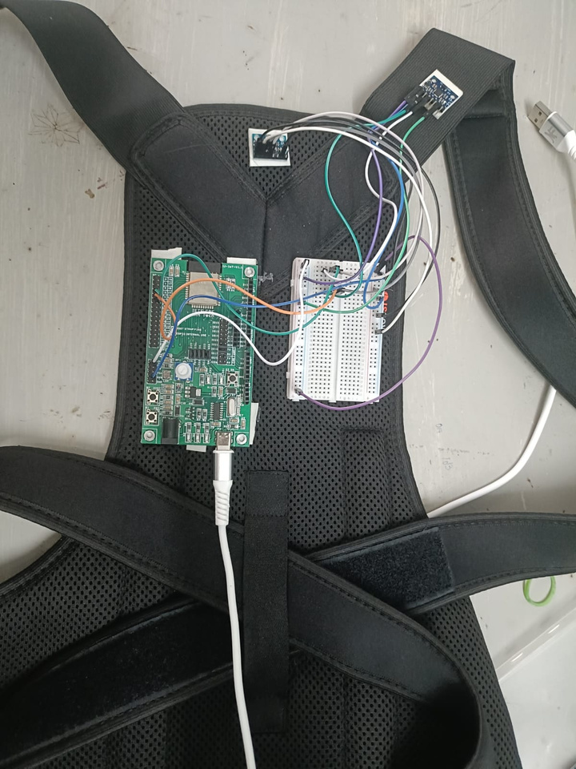
07
Data collection:
No of people =5
No of samples = 2000 (1000-good posture,1000-bad posture)

Slide 8
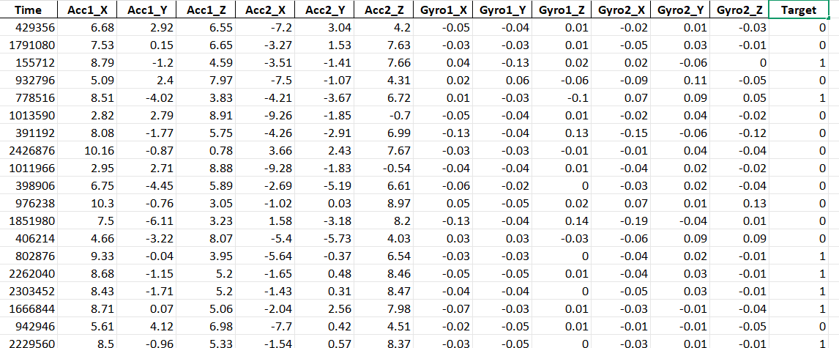
08
DATA SET OVERVIEW:
Labels:
0→ Good Posture
1→ Bad Posture

Slide 9
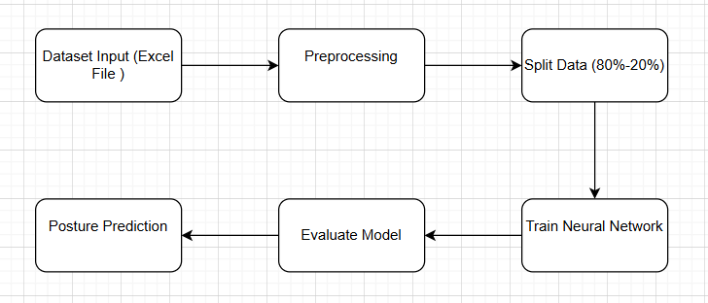
09
NEURAL NETWORK:
We are using the most basic type of artificial neural network Feedforward Neural Network (FNN) to train our dataset .
DATA PREPROCESSING:
Handle Missing Values
Feature Normalization
One-Hot Encoding of Labels
Split Data into Training & Testing Sets
Shuffle the Data

Slide 10
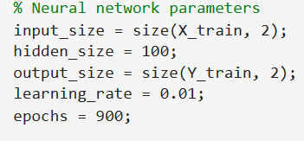
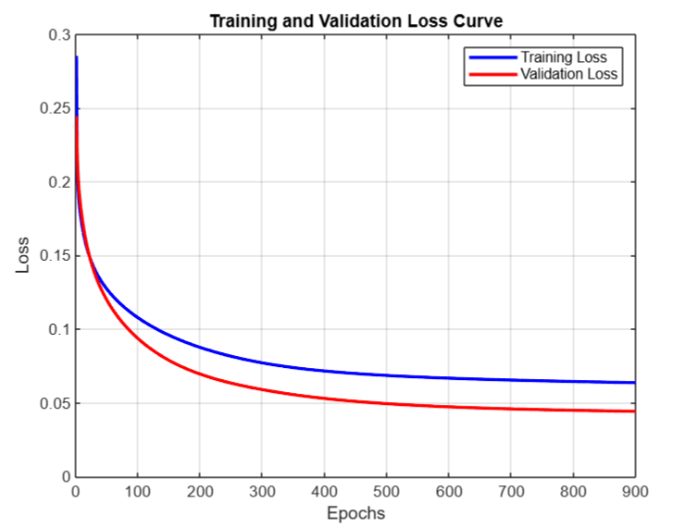
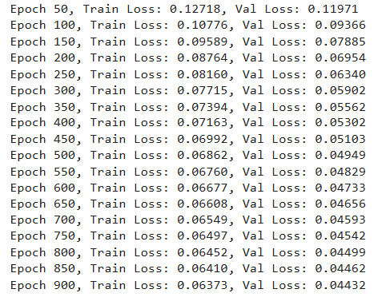
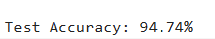
10
HYPER TUNING PARAMETERS:
ACCURACY AND LEARNING CURVE:
EPOCHS VS LOSS:

